Slide 1

Sales Data Analysis Report
By – Shalini Pal

Slide 2
Project Title - | Analyzing Amazon Sales Data
Technologies - | Data Science
Domain - | E-Commerce

Slide 3
Introduction
Amazon.com is an American multinational technology company focusing on e-commerce, cloud computing, online advertising, digital streaming, and artificial intelligence.
Sales management has gained importance to meet increasing competition and the need for improved methods of distribution to reduce cost and to increase profits. Sales management today is the most important function in a commercial and business enterprise

Slide 4







Technologies Used –

Slide 5
KPI’s (Key Performance Indicators)
Units Sold - Unit sales refers to the number of individual items that a company sells.
Unit Price - The unit selling price is the amount a company charges for a single item of a product or use of a service.
Unit Cost - A unit cost is the total expenditure incurred by a company to produce, store, and sell one unit of a particular product or service.
Total Revenue(Sales amount) - Total revenue is all income generated from the total sales of goods and services regardless of revenue source
Total Cost - The cost of sales (COS) is the total of all direct costs involved in making a product or service ready for sale.
Total Profit(Sales margin amount)- Gross profit, also known as sales profit or gross income, is the profit a business makes after subtracting the cost of goods sold from the total sales
Order Date – Date on which customer has placed the order.

Slide 6
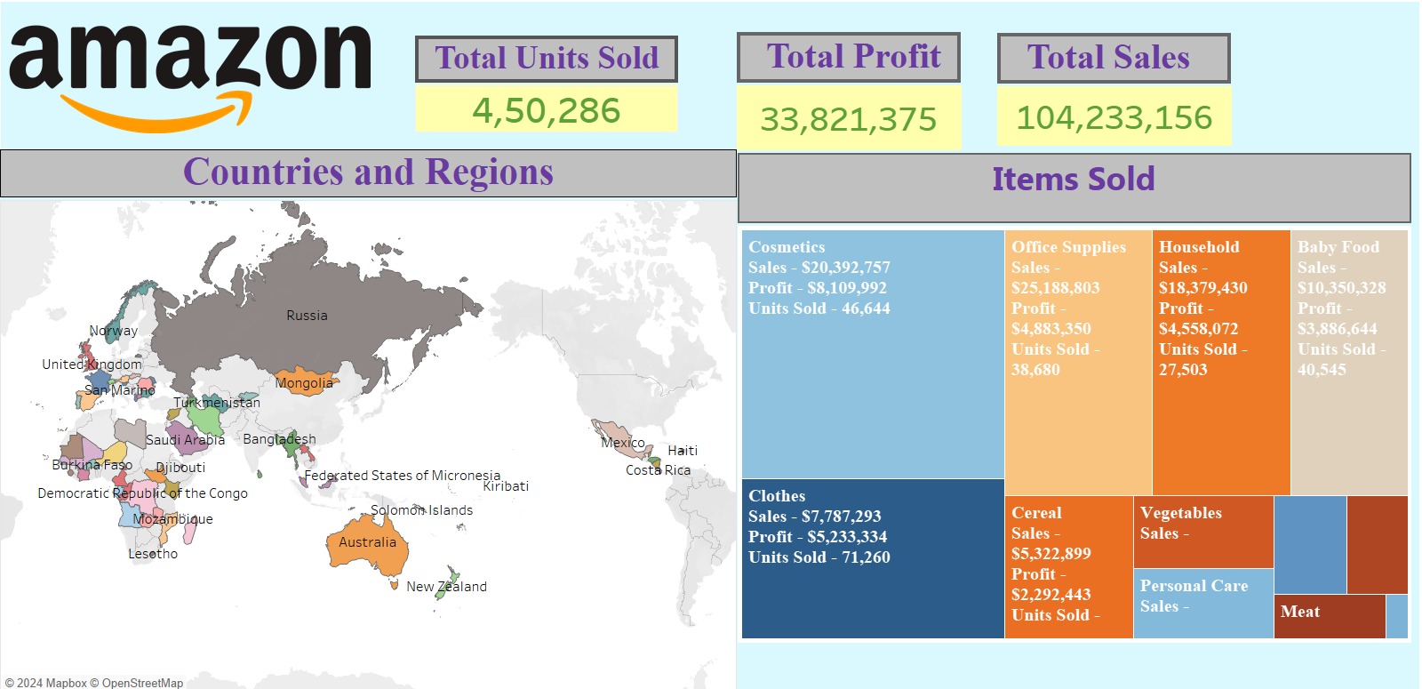
Sales by Location

Slide 7
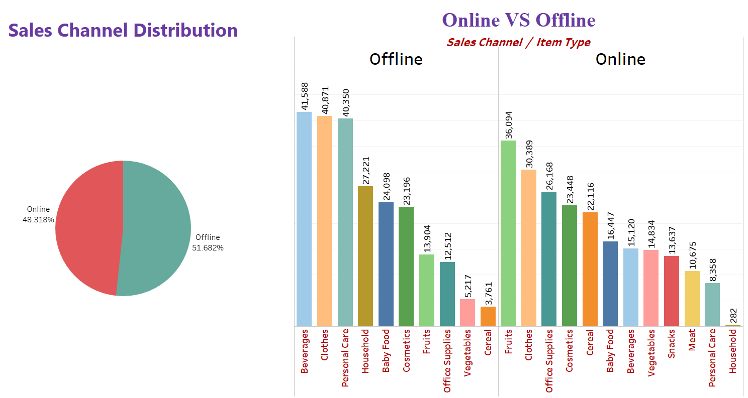
Sales By Channel

Slide 8
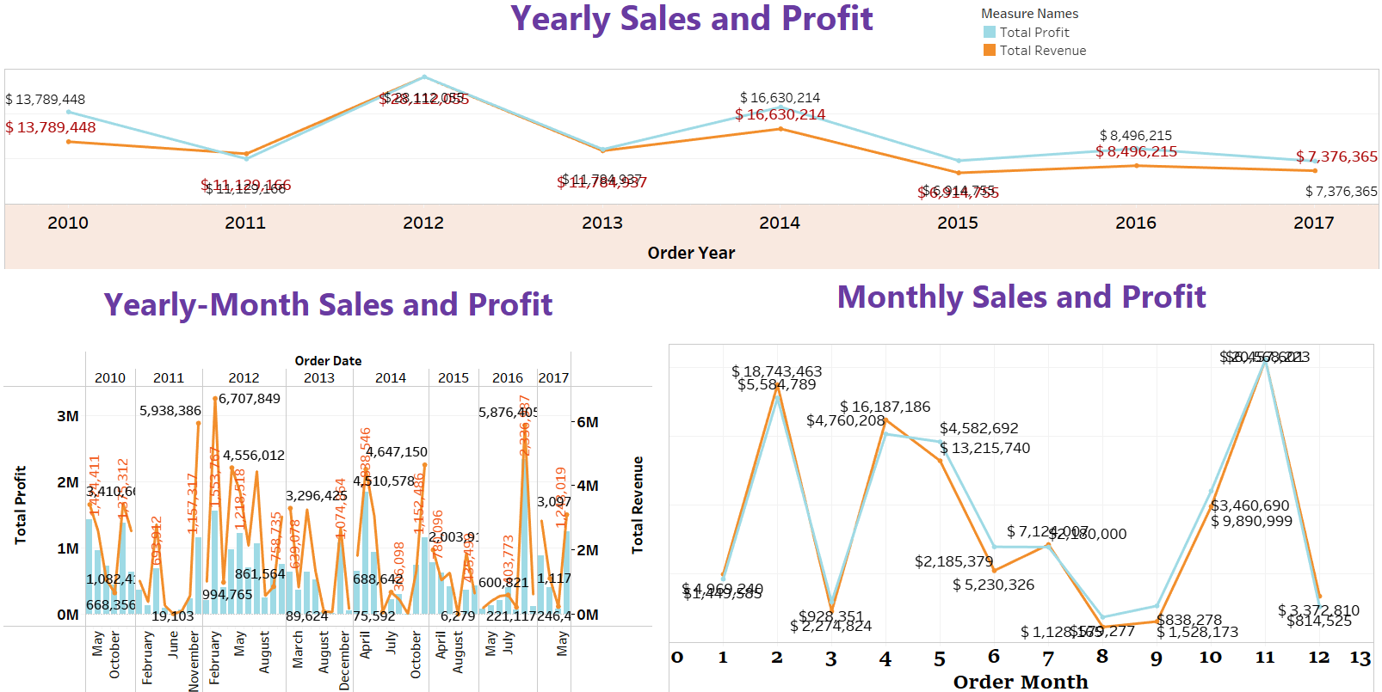
Yearly, Monthly and Yearly-Month wise Sales

Slide 9
Thank You!

